Slide 1
Ch 4. The Network Layer from Computer Networking by J. Kurose
Myungchul Kim
mck@kaist.ac.kr

Slide 2
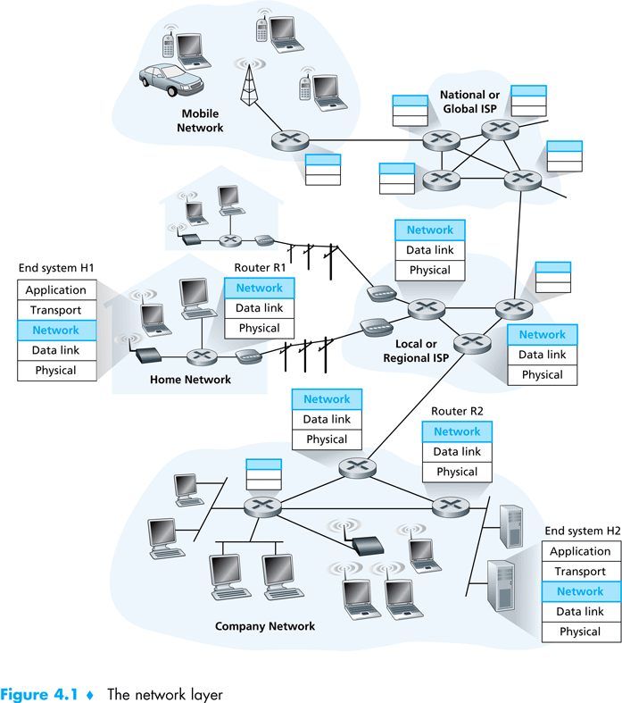

Slide 3
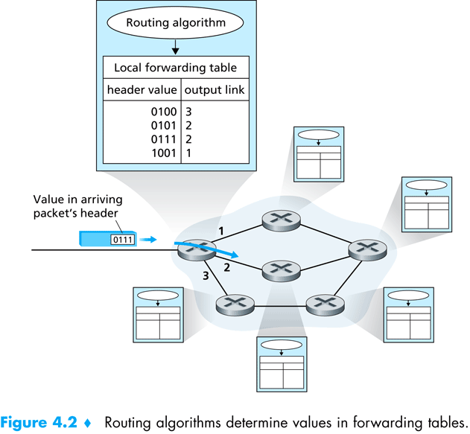

Slide 4
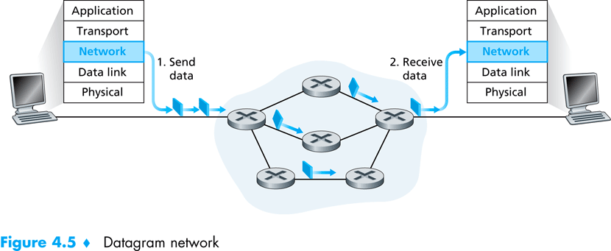
Datagram networks
  Prefix match
  Longest prefix matching rule
  Forwarding tables can be modified at any time -> packets go different paths and arrive out of order

Slide 5
Forwarding table
4 billion
possible entries
Destination Address Range Link Interface
11001000 00010111 00010000 00000000
through 0
11001000 00010111 00010111 11111111
11001000 00010111 00011000 00000000
through 1
11001000 00010111 00011000 11111111
11001000 00010111 00011001 00000000
through 2
11001000 00010111 00011111 11111111
otherwise 3

Slide 6
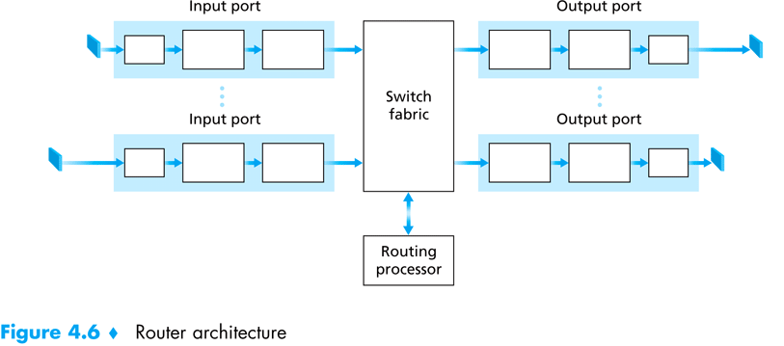
What’s inside a router

Slide 7
Where does queuing occur
  Packet queue can form at both the input ports and the output ports
  Packet loss
  Packet scheduler at the output port must choose one packet among those queued for transmission
    First-come-first-served
    Weighted fair queueing
    For quality-of-service guarantees

Slide 8
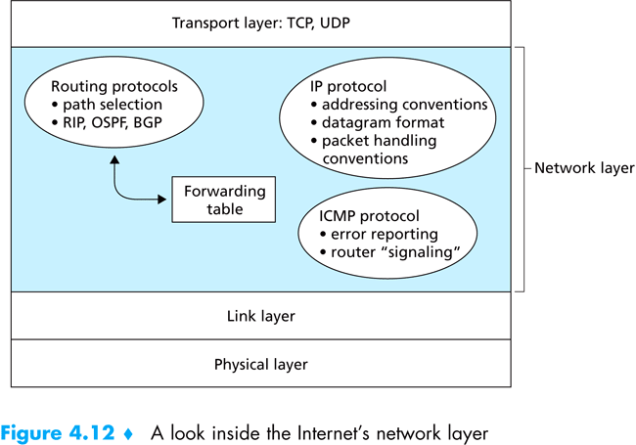
IP: forwarding and addressing in the Internet

Slide 9
Routing algoritms
  Default router: the first-hop router
  The least cost path
  Global routing algorithm: link-state (LS) algorithms
  Decentralized routing algorithm: distance-vector (DV) algorithms
  Static routing algorithms vs dynamic routing
  Load-sensitive algorithms vs load-insensitive

Slide 10
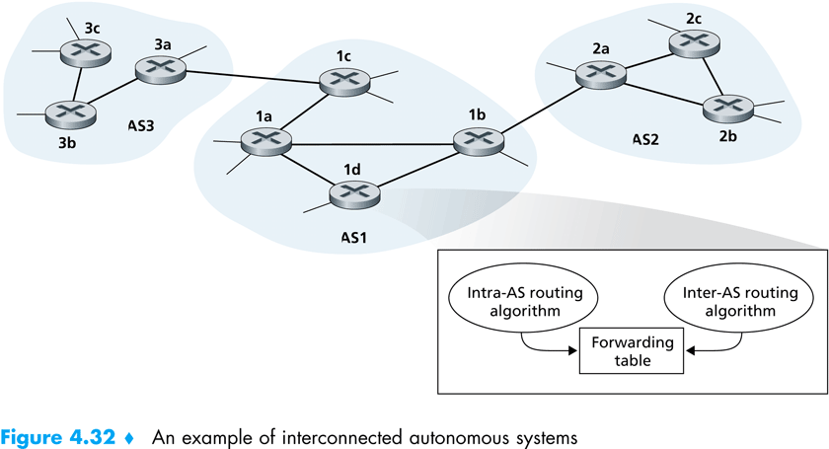
Hierarchical routing
  Autonomous systems (ASs)
  Gateway routers
  Within an AS, all routers run the same intra-AS routing protocol.
  The ASs run the same inter-AS routing protocol.

Slide 11
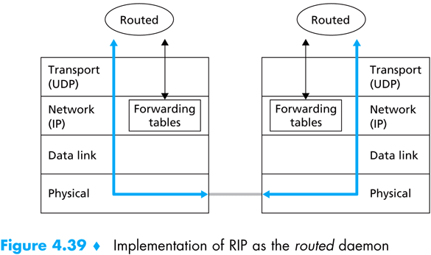
Routing in the Internet
RIP (routing information protocol)
  DV protocol
  Hop count as a cost metric (max 15)
  Routing updates every 30 seconds

Slide 12
OSPF(open shortest path first)
  LS protocol
  Link’s state updates every 30 minutes
  Advantages:
    Security: MD5
    Multiple same-cost paths
    Integrated support for unicast and multicast routing
    Support for hierarchy within a single routing domain

Slide 13
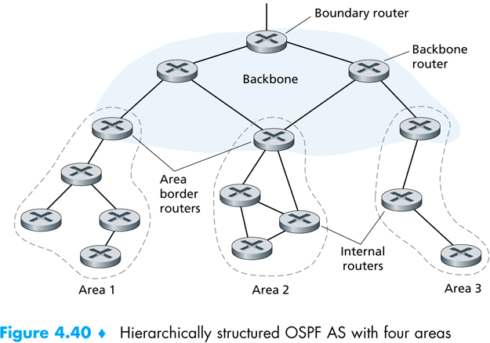

Slide 14
Routing Algorithms
(Ch5 of Computer Network by A. Tanenbaum)
  Shortest path routing
    static
    simple and easy to understand.
    Metric for a shortest path: distance, bandwidth, average traffic, communication cost, mean queue length, measured delay, ….

Slide 15
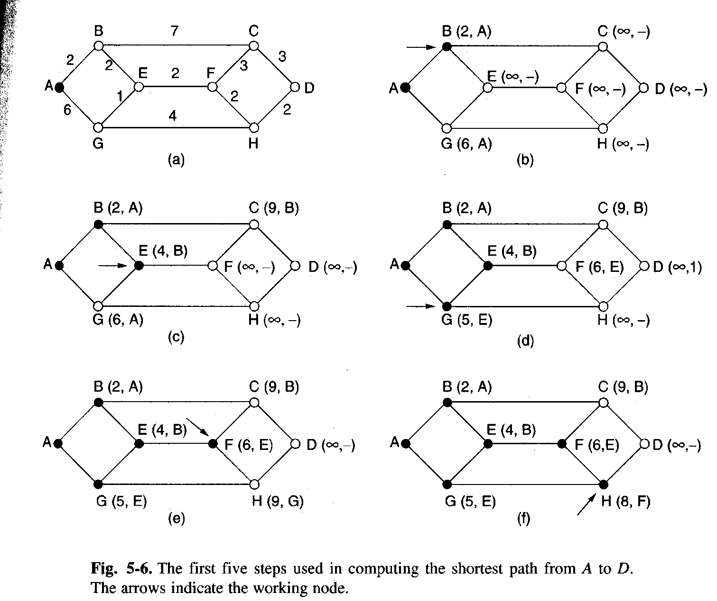
    Dijkstra (1959):

Slide 16
  Flooding
    Static
    Every incoming packet is sent out on every outgoing line except the one it arrived on.
    Damming the flood
      Hop counter
      Keep track of which packets have been flooded
    Selective flooding: only on those lines that are going approximately in the right direction
    Flooding always chooses the shortest path.
    No other algorithm can produce a shorter delay.
    Overhead

Slide 17
  Distance vector routing
    dynamic
    each router maintains a table (vector) giving the best known distance to each destination and which line to use to get there.
    Distributed Bellman-Ford routing algorithm and the Ford-Fulkerson algorithm.
    Original ARPANET routing algorithm.
    Routing Information Protocol (RIP)
    one entry for each router.
    Metric: hopes, queue length, delay.

Slide 18
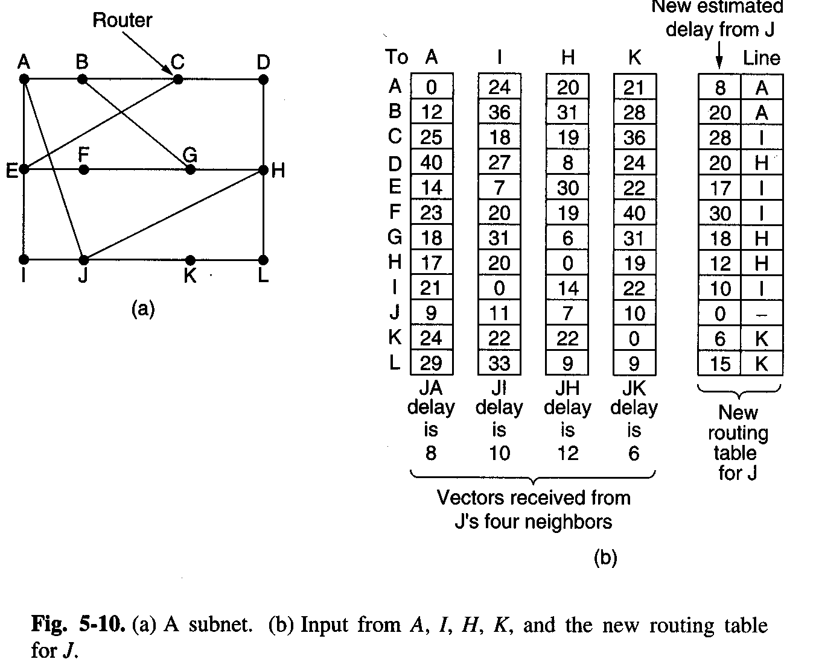

Slide 19
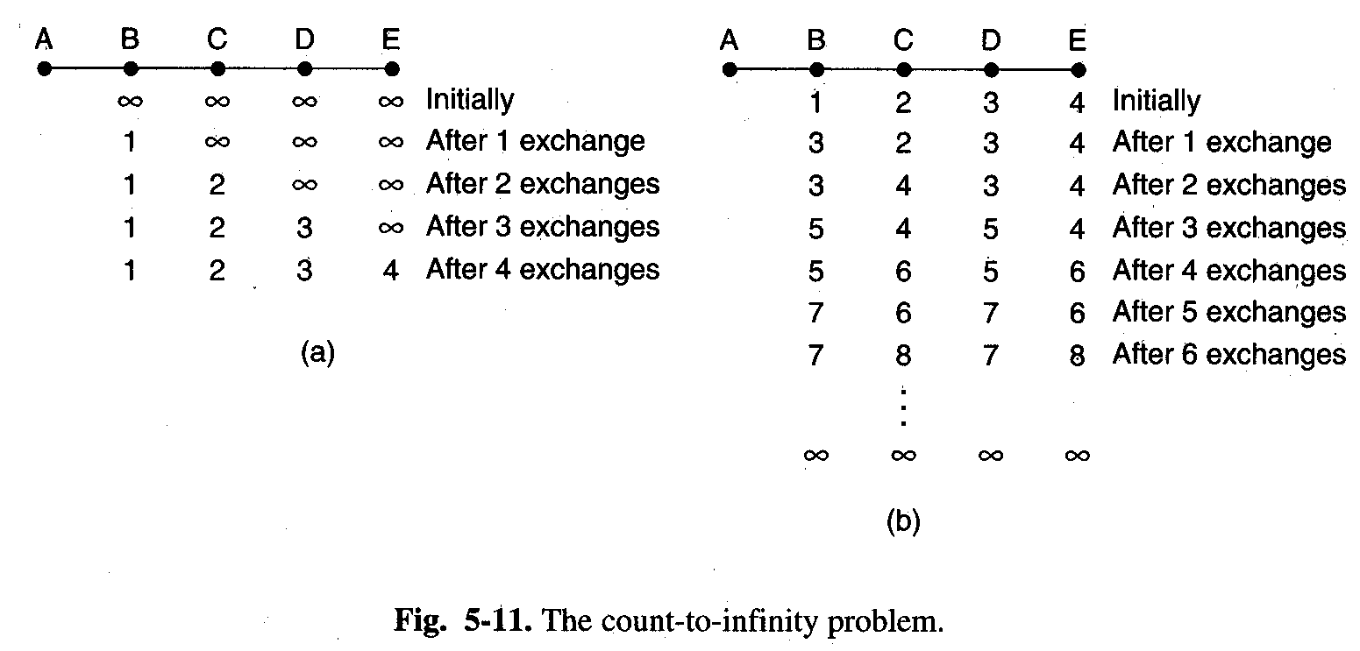
    The count-to-infinity problem
      serious drawback in practice.
      Reacts rapidly to good news, but leisurely to bad news.
      why bad news travels slowly: no router ever has a value more than one higher than the minimum of all its neighbors. -> set infinity to the longest path plus 1.

Slide 20
  Link state routing
    demise of distance vector routing
      did not take line bandwidth into account
      often took too long to converge.
    Idea behind link state routing
      discover its neighbors and learn their network address.
      measure the delay or cost to each of its neighbors.
      construct a packet telling all it has just learned.
      send this packet to all other routers.
      compute the shortest path to every other router.

Slide 21
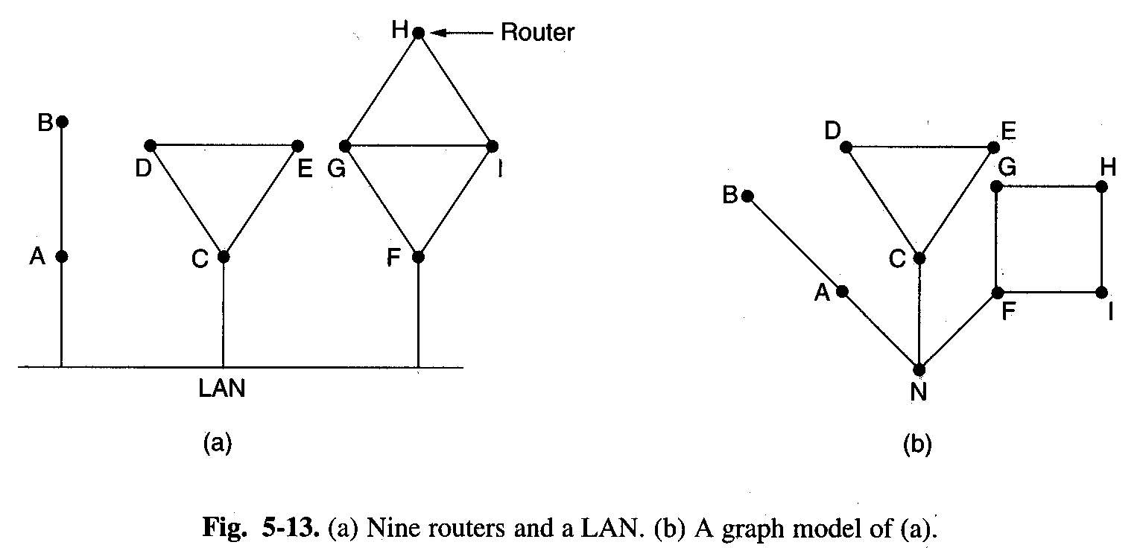
    1. Learning about the neighbors.
      Send a special HELLO packet on each point-to-point line after a router is booted.
      Send back a reply telling who it is.

Slide 22
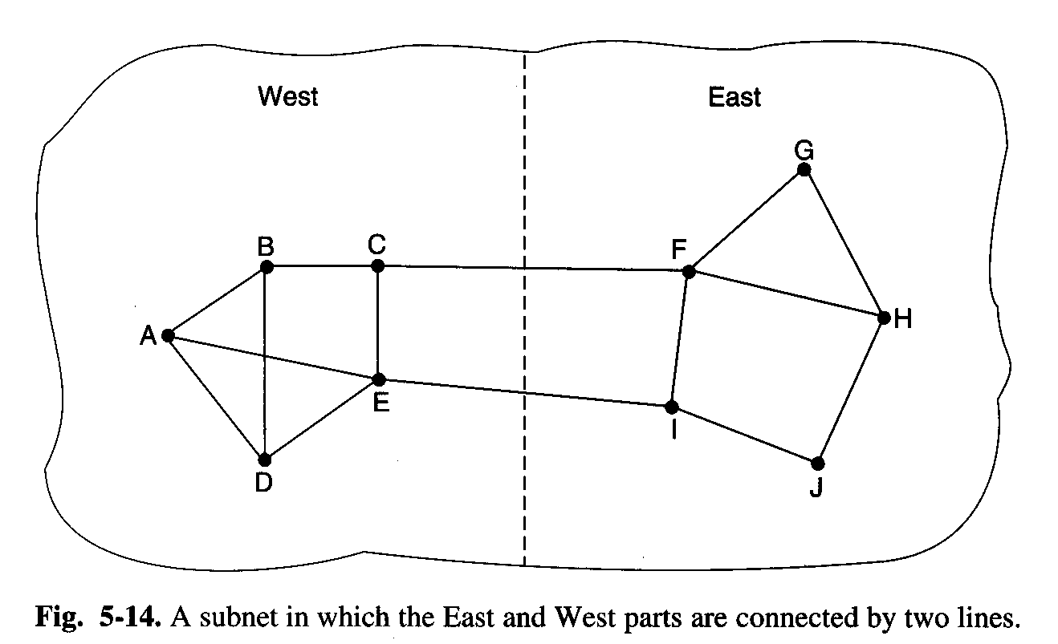
    2. Measuring line cost
      each router know the delay to each of its neighbors by sending a special ECHO packet.
      Whether or not to take the load into account when measuring the delay.
      The routing tables may oscillate wildly.

Slide 23
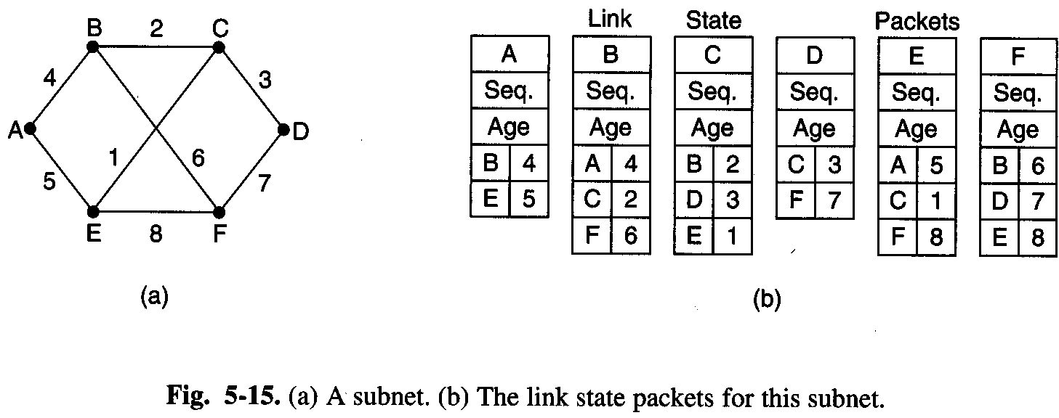
    3. Building link state packets
      the hard part is determining when to build them: periodically or some significant event occurs.

Slide 24
    4. Distributing the link state packets
      Idea
        Use flooding to distribute the link state packets.
        Routers keep track of all the (source router, sequence) pairs they see.
        If it is new, forward on all lines except the one it arrived on.
        If a duplicate, discard.
        If a sequence number lower, reject.
      A few problems
        sequence numbers wrap around.
        router crashes (starts again at 0)
        sequence number is corrupted.

Slide 25
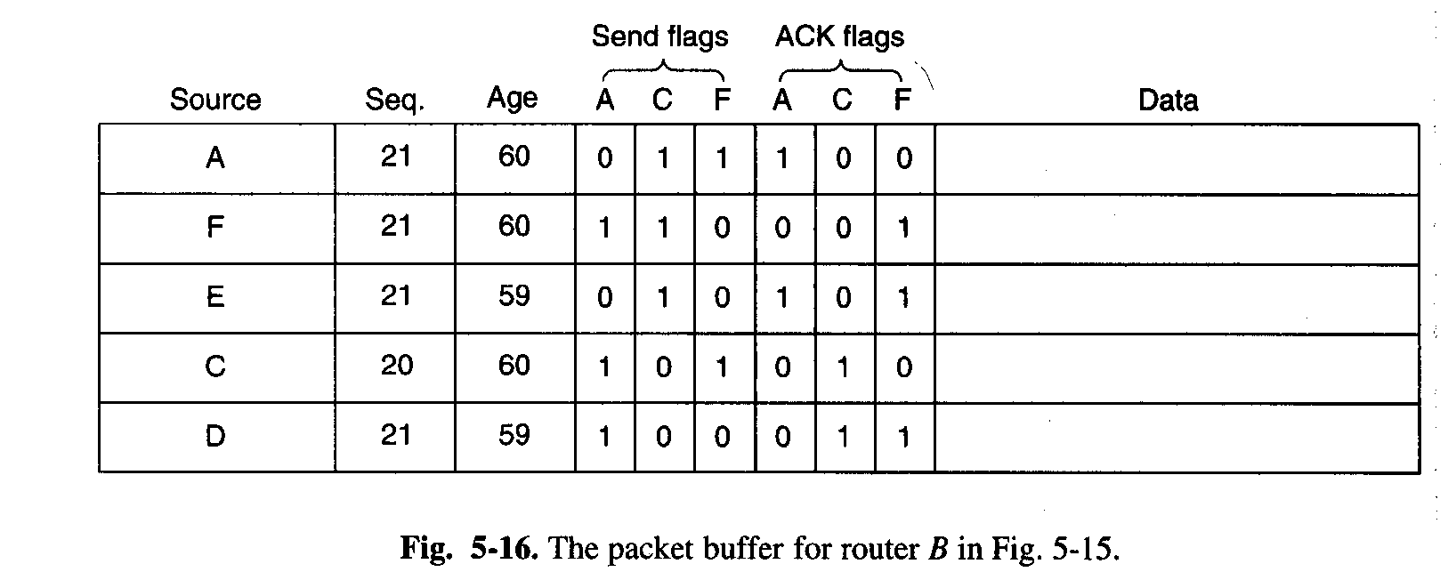
      Solution: when the age hits zero, the information from that router is discarded. The age field is decremented by each router during the initial flooding process.
      The send flags mean that the packet must be sent on the indicated line. The acknowledgement flags mean that it must be acknowledged there.

Slide 26
    5. Computing the new routes
      after accumulating a full set of link state packets, the entire subnet graph can be constructed.
      Dijkstra’s algorithm
      n routers with each of which has k neighbors -> the memory is proportional to kn.
      IS-IS, OSPF

Slide 27
  Broadcast routing
    send a packet to all destinations simultaneously
      Send a distinct packet to each destination
      Flooding
      Multidestination routing
      Sink tree or spanning tree: includes all the routers but contains no loops

Slide 28
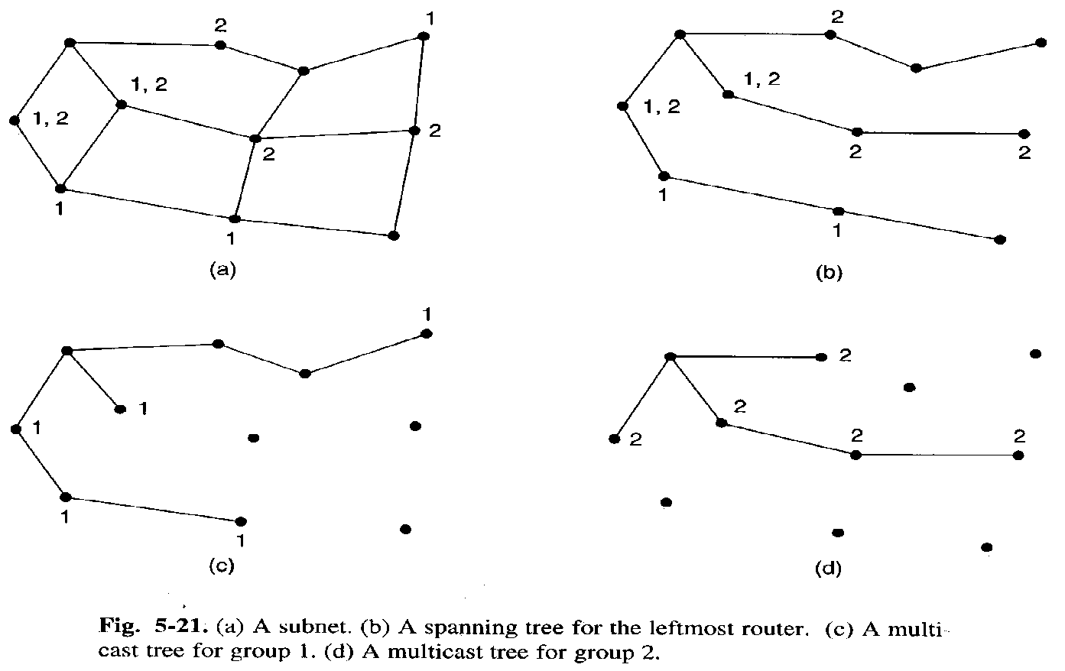
  Multicast routing
    send messages to well-defined groups that are numerically large in size but small compared to the network as a whole.
    Group management is required. Routers know which of their hosts belong to which groups.

Slide 29
Routing in the Internet
Intra-AS routing: RIP and OSPF
Routing Information Protocol
  Distance vector protocol
  Hop count as a cost metric
  Max cost of a path: 15
  Every 30 seconds for RIP advertisements
Open Shortest Path First
  Link state protocol
  Once every 30 minutes
  Adv.: security, multiple same-cost paths, integrated support for unicast and multicast routing, and support for hierarchy within a single routing domain.

